Slide 1

Section 2.6 Transformations of Functions
Lecture 2
x-Transformations and Messy Combinations
Notes:
Note, skip 2.5, more on lines, focus is on thinking linear. Similar ideas to previous lectures

Slide 2
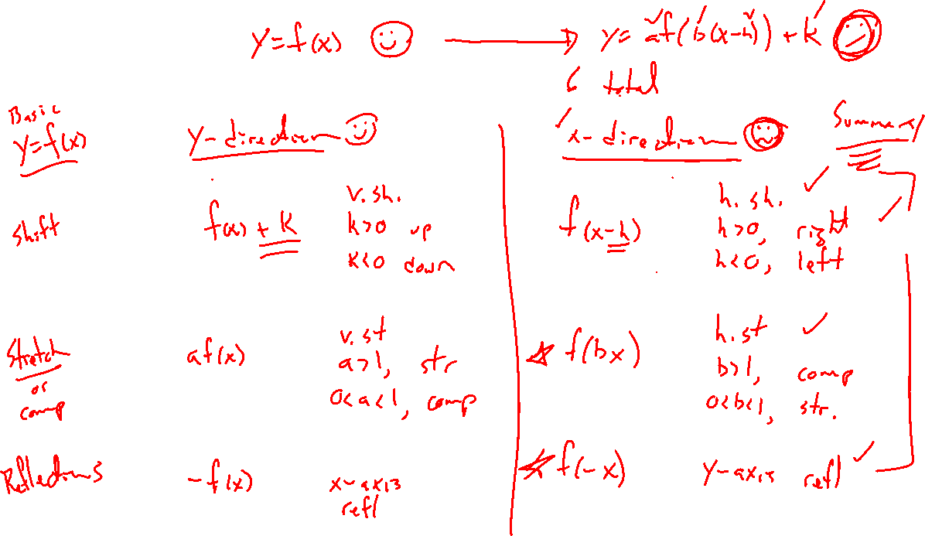
Recall: Transformation List
Notes:
Finished y direction (easy ones)
Need x
Then combination of all

Slide 3
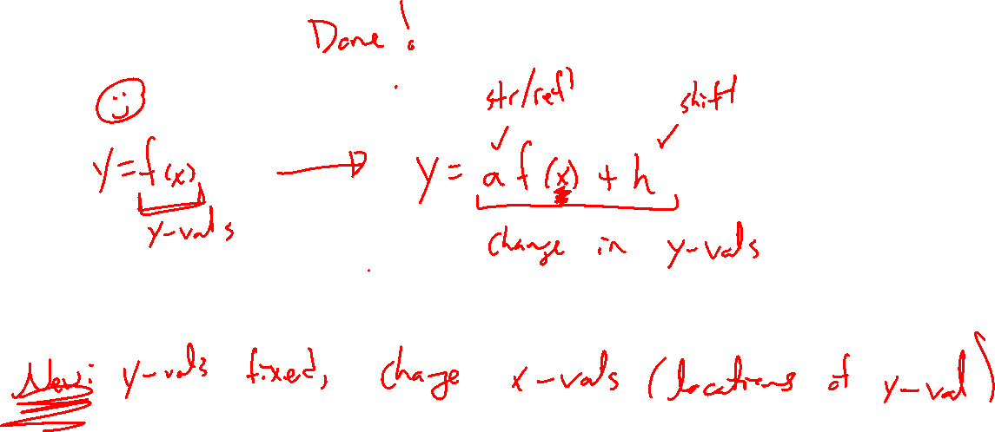
Y-Direction Transformations
Notes:
Y=f(x)+k
Y = af(x)
Y = -f(x)
Combinations, y=-af(x)+k

Slide 4
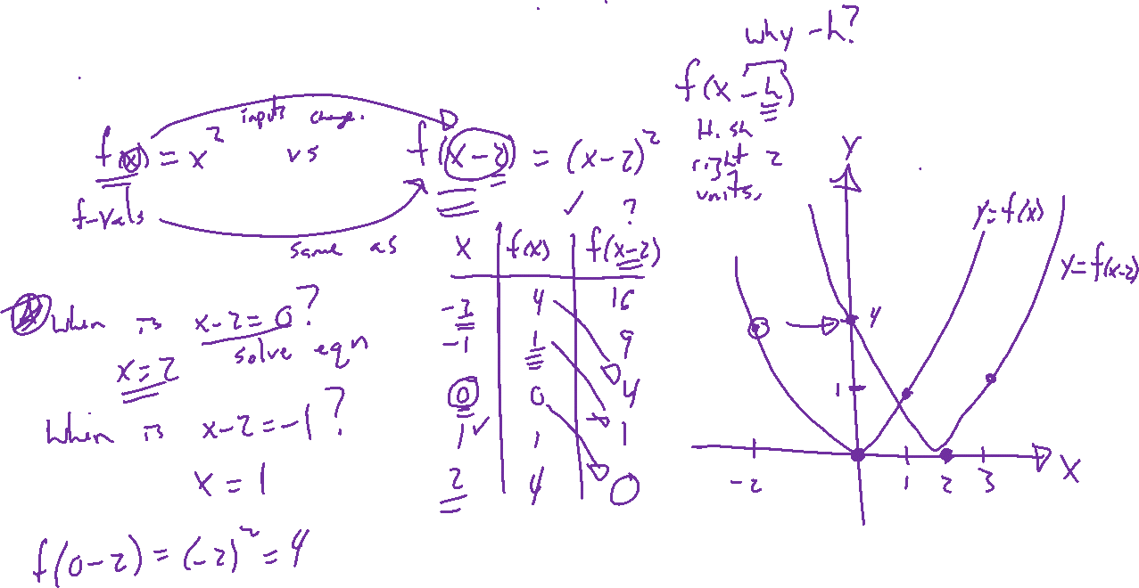
Example: Horizontal Shift
Notes:
F(x-h), how is the output of f changed? Note, output stays same, input location changes
Why minus?
Y=f(x)=x^2
F(x-2), +3
Use Desmos tables. Draw -2 carefully on slide. Keep track of three points moving.

Slide 5
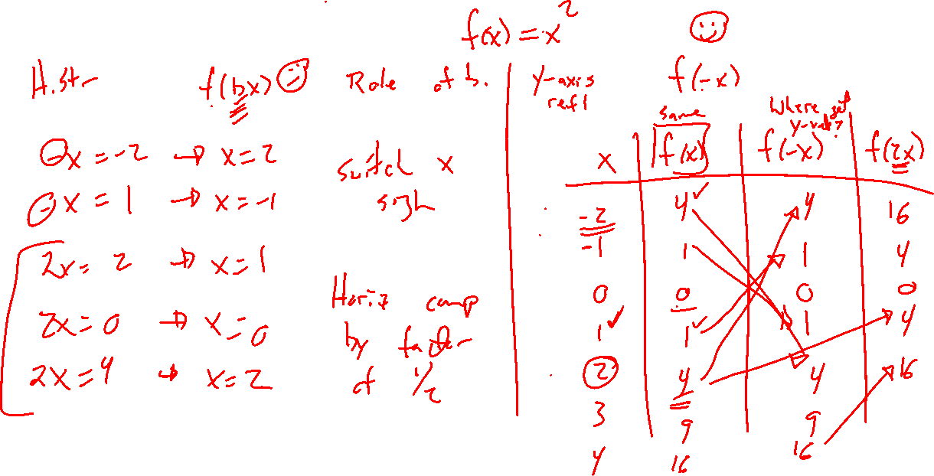
Example: Try on Own
Notes:
Remaining 2, f(bx), f(-x)
Try in Desmos for various choices. Explain what happens.
Note the reversing of horiz stretch
Trace points

Slide 6
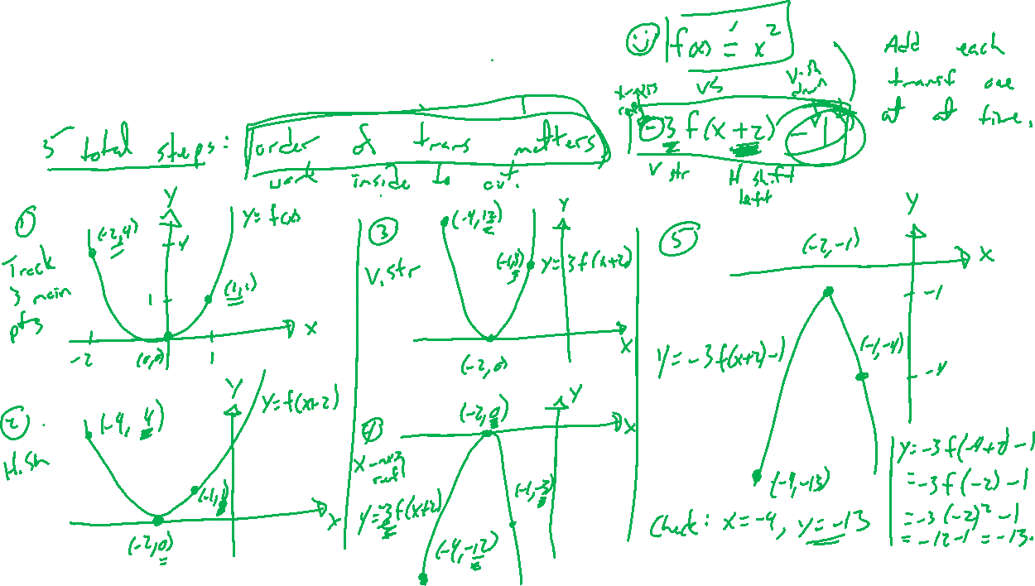
Combining Transformations
Notes:
Example: Knowing the graph of y=x^2, graph instead y=-3(2(x-1))^2+2.
Break into many steps. Order of steps matters. Track three main points. Show how to check in end.
Trace points

Slide 7
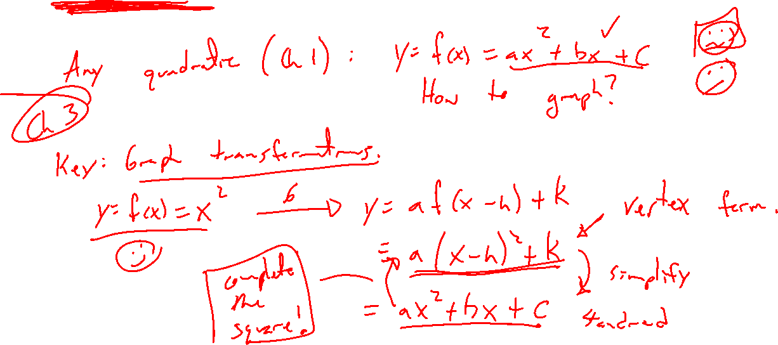
Parabolas and the Power of Transformations
Notes:
Standard form ax^2+bx+c
To
Vertex form a(x-h)^2+k
Complete the square, use transformations of x^2

Slide 8
Example: Try on Own
Notes:
F(x)=|x|
Identify transformations and order –2f(x-4)+3
Graph and check via desmos. Trace 3 main points.

